Slide 1



Group: 10 Section: A Project: Prediction of Loan Default (Status) using Home Equity Credit Data from the US
Pavan Kalyan Lingineni CWID: 20007180
Shubham Atre
CWID: 20023081
Sharv Kulkarni
CWID: 20025510

Slide 2
Introduction and Problem Statement
Following the 2008 financial crisis, there has been a lot of talk about the issue of credit risk management and several contributory factors of loan default.
It is estimated that banking assets account for about 56 percent of the United States economy. To that end, the magnitude of the risk faced by banks in the event of loan defaults has a negative consequence not only on the US but the entire global economy.
The banking industry look down on machine learning techniques when it comes to loan default and credit prediction.
In this project, we intend to model whether a credit borrower will default on their obligations or not.

Slide 3
Description of the Dataset
The data used is a loan level data downloaded from the International Financial Research and Credit Risk Analytics.
The dataset contains characteristics and delinquency information for about 6,000 home equity loans in the United States. The variables contained in the dataset are described as follows:
BAD: 1 = applicant defaulted on loan or seriously delinquent; 0 = applicant paid loan
LOAN: Amount of the loan request
MORTDUE: Amount due on existing mortgage
VALUE: Value of current property REASON:
DebtCon = debt consolidation;
HomeImp = home improvement
JOB: Occupational categories
YOJ: Years at present job
DEROG: Number of major derogatory reports
DELINQ: Number of delinquent credit lines
CLAGE: Age of oldest credit line in months
NINQ: Number of recent credit inquiries CLNO: Number of credit lines
DEBTINC: Debt-to-income ratio

Slide 4
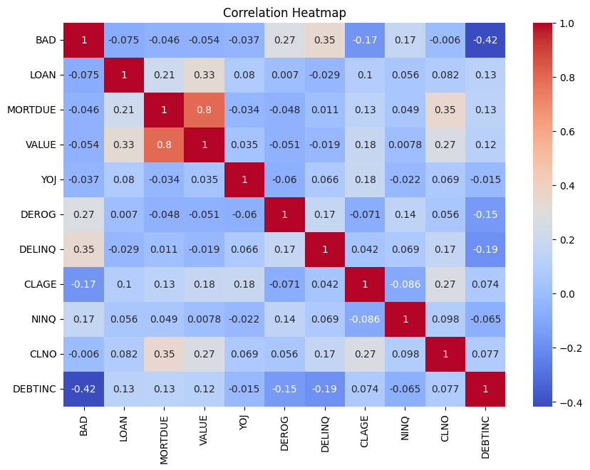
Correlation heatmap displaying the correlation coefficients between pairs of numerical features in the dataset.
Exploratory Data Analysis

Slide 5
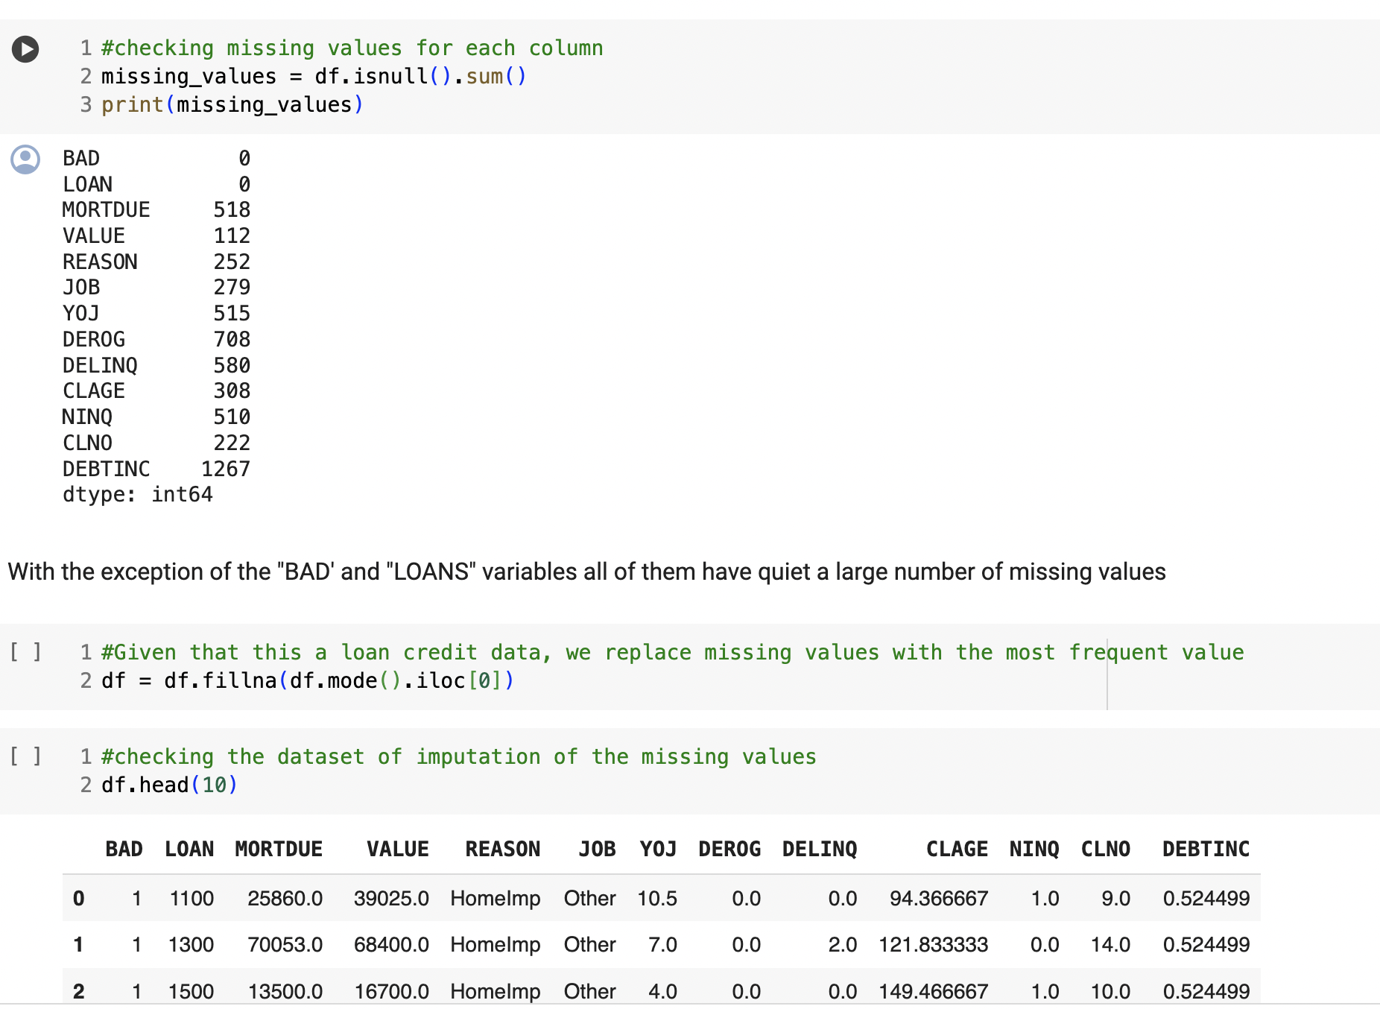

Slide 6
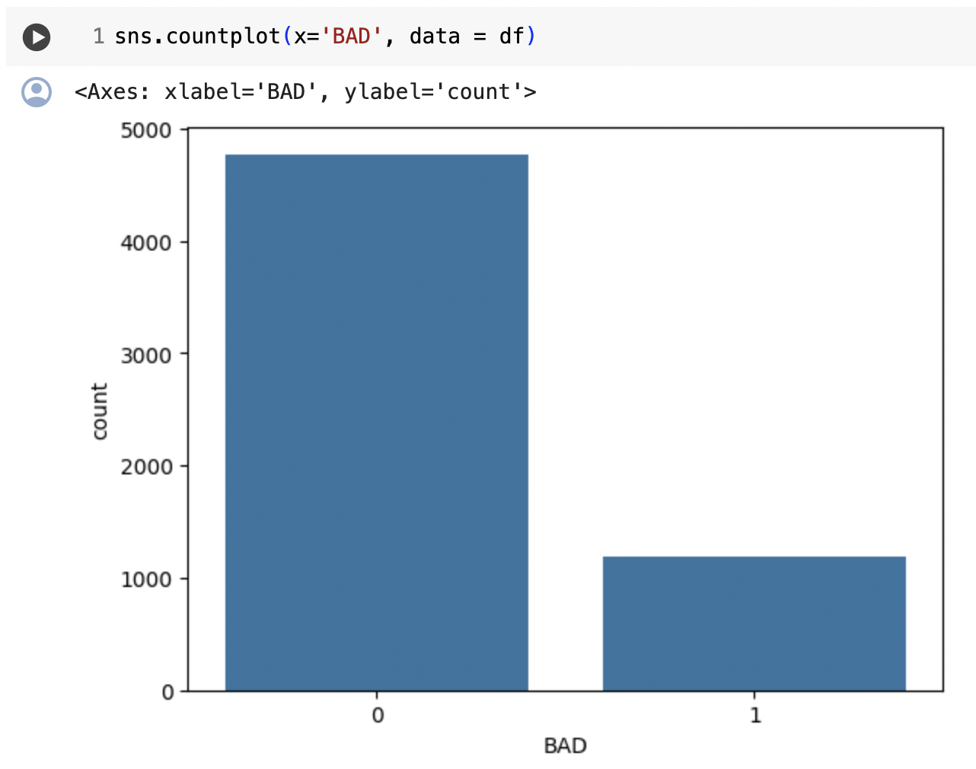
The count plot of target variables in the BAD attribute

Slide 7

Models trained on the dataset
Random Forest
Naïve Bayes
Artificial Neural Network
K- Nearest Neighbours
Support Vector Machines
Classification and Regression Tree

Slide 8
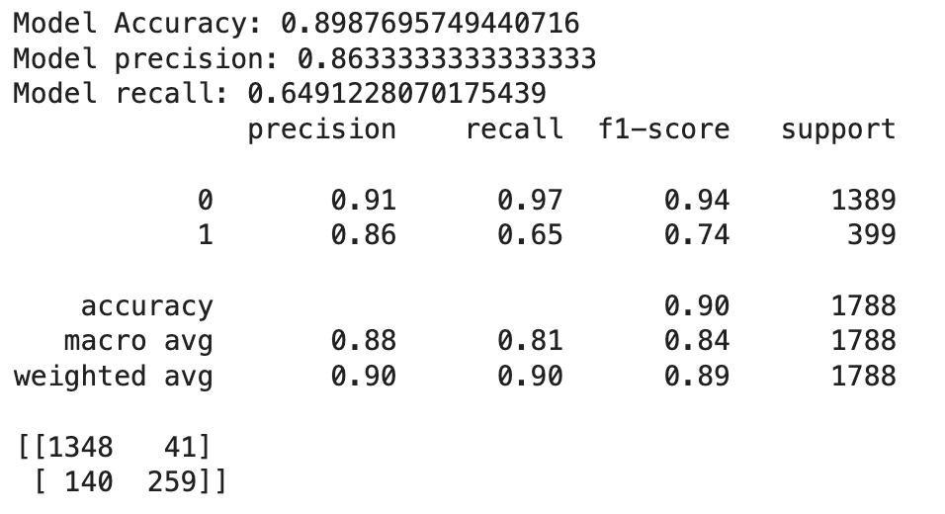
Random Forest Classifier

Slide 9
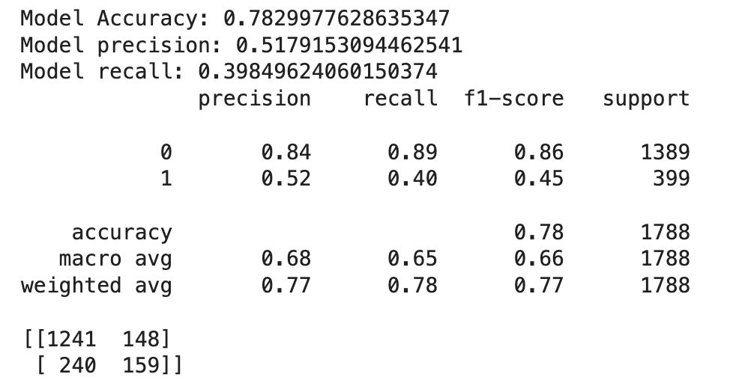
Naïve Bayes Classifier

Slide 10
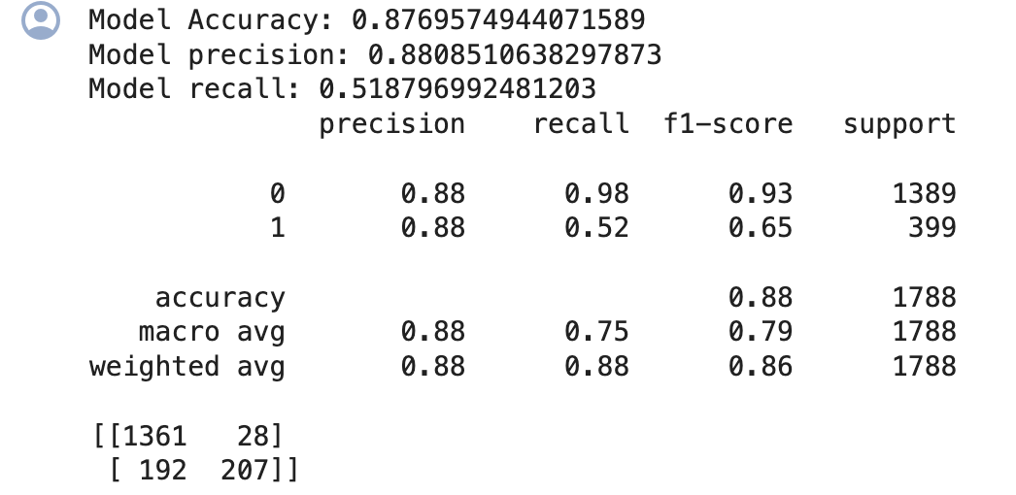
K – Nearest Neighbors

Slide 11
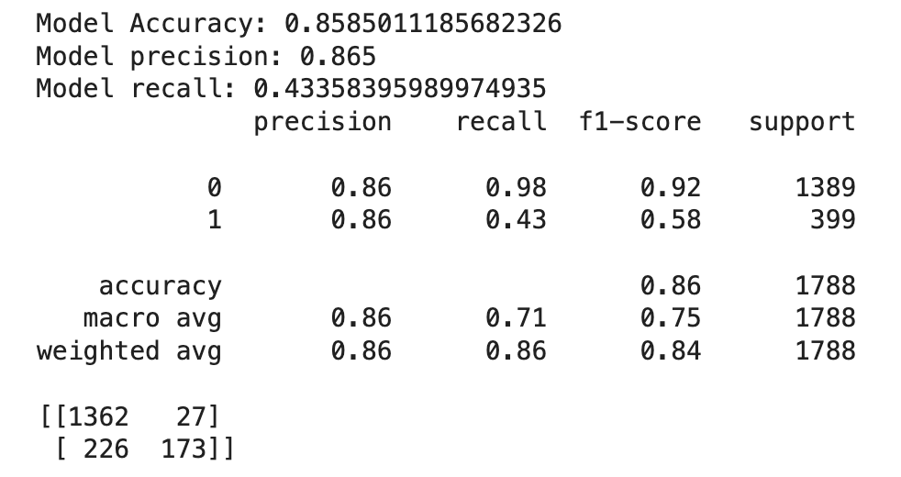
Artificial Neural Network

Slide 12
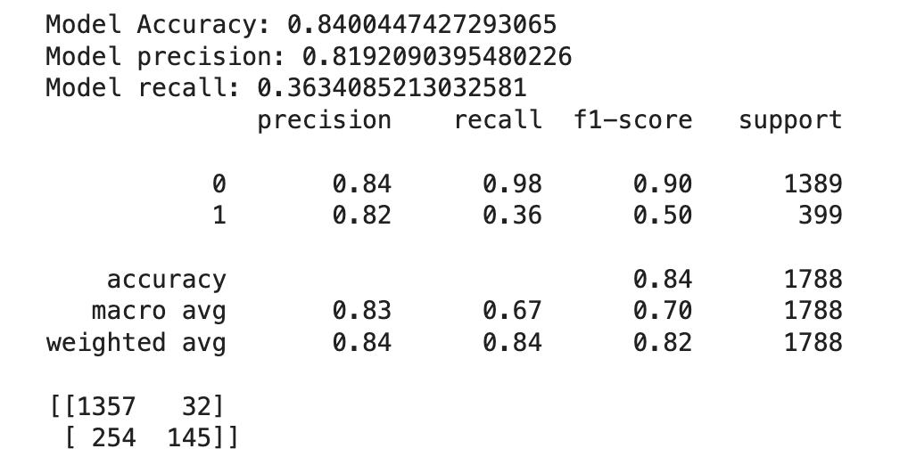
Support Vector Machine

Slide 13
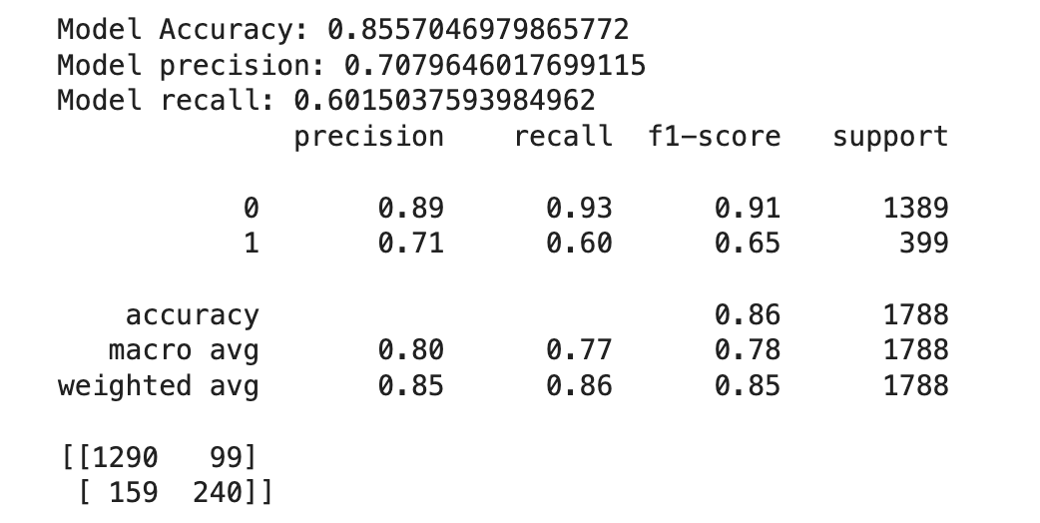
CART Methodology

Slide 14
Model comparison & Conclusion
We evaluated 6 classification models using accuracy and F-1 score and found that all the models performed decently in the accuracy range of 78.29% - 89.87%.
Top performing model was Random Forest with accuracy equal to 89.87% and F-1 score equal to 0.84.

Slide 15
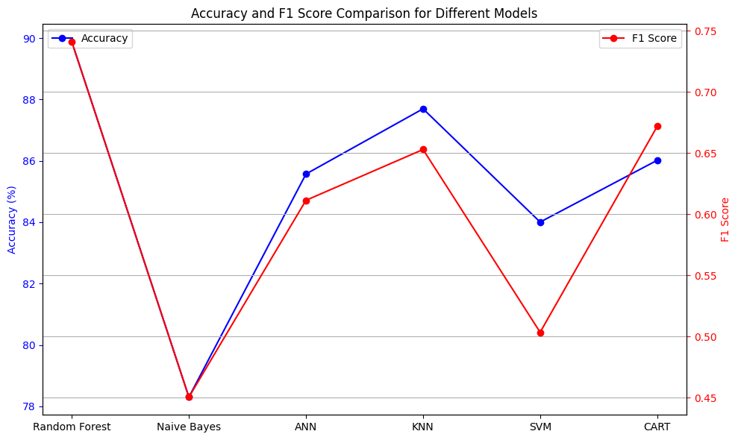
Accuracy vs F-1
By visualizing these accuracies/F-1 scores on the line graph, we can easily compare their relative performance and identify the top performers.

